Slide 1
NotPetya
One of The Most Devastating Cyberattack in History

Slide 2


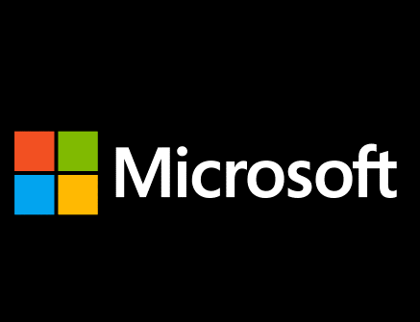
Kaif Ahsan
the Most Devastating Cyberattack in History

Slide 3
What’s the worst thing that can happen from a cyberattack?

Slide 4
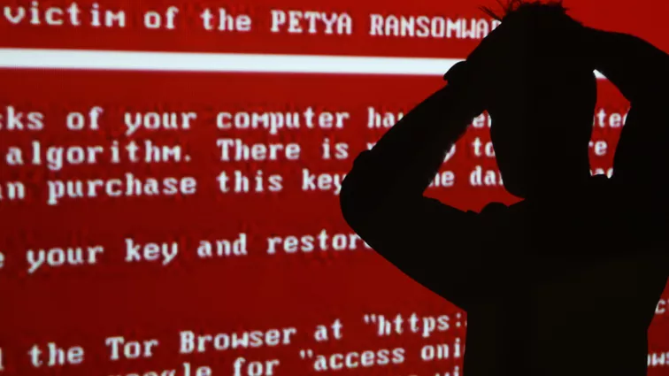
Notes:
Pablo Bondorenko – Health Ministry

Slide 5
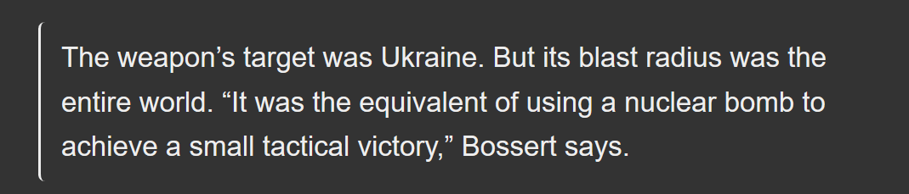
Damage on Ukraine
The radiation monitoring system at Ukraine's Chernobyl Nuclear Power Plant went offline
Several Ukrainian ministries, banks, metro systems and state-owned enterprises
1,500 legal entities and individuals
Notes:
Tom Bossert, former Homeland security advisor to the president.
Boryspil International Airport, Ukrtelecom, Ukrposhta, State Savings Bank of Ukraine, Ukrainian Railways)
The attack has been seen to be more likely aimed at crippling the Ukrainian state rather than for monetary reasons

Slide 6
Notable Companies Affected by NotPetya
Maersk
FedEx
Merck
Mondelēz (Cadbury & Nabisco)
And almost 300 More!

Slide 7

Notes:
15 percent of world’s shipping capacity

Slide 8
$10,000,000,000,000

Slide 9
National State Level Sophistication

Slide 10
An Autopsy Report
1. Disguised as a ransomware worm. Similarity to Petya
2. Combined with two very powerful exploits
3. Linkos group’s M.E.Doc was used to spread the malware

Slide 11
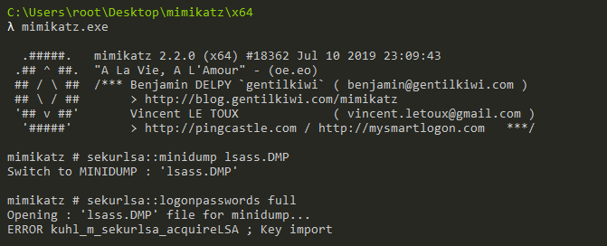
Mimikatz
Tool to extract plaintexts passwords, hash, PIN code and Kerberos tickets from memory.
Takes advantage of Lsass.exe
Pass hashes, tickets, Kerberos golden and silver tickets
Notes:
Pass-the-Hash: Windows used to store password data in an NTLM hash. Attackers use Mimikatz to pass that exact hash string to the target computer to login. Attackers don’t even need to crack the password, they just need to use the hash string as is. It’s the equivalent of finding the master key to a building on the floor. You need that one key to get into all the doors.
Pass-the-Ticket: Newer versions of windows store password data in a construct called a ticket. Mimikatz provides functionality for a user to pass a kerberos ticket to another computer and login with that user’s ticket. It’s basically the same as pass-the-hash otherwise.
Over-Pass the Hash (Pass the Key): Yet another flavor of the pass-the-hash, but this technique passes a unique key to impersonate a user you can obtain from a domain controller.
Kerberos Golden Ticket: This is a pass-the-ticket attack, but it’s a specific ticket for a hidden account called KRBTGT, which is the account that encrypts all of the other tickets. A golden ticket gives you domain admin credentials to any computer on the network that doesn’t expire.
Kerberos Silver Ticket: Another pass-the-ticket, but a silver ticket takes advantage of a feature in Windows that makes it easy for you to use services on the network. Kerberos grants a user a TGS ticket, and a user can use that ticket to log into any services on the network. Microsoft doesn’t always check a TGS after it’s issued, so it’s easy to slip it past any safeguards.
Pass-the-Cache: Finally an attack that doesn’t take advantage of Windows! A pass-the-cache attack is generally the same as a pass-the-ticket, but this one uses the saved and encrypted login data on a Mac/UNIX/Linux system.

Slide 12
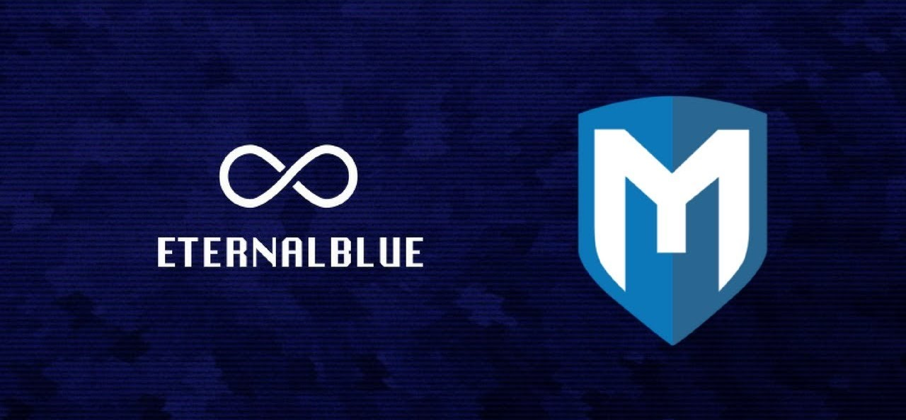
Eternal Blue
Developed by NSA, leaked by Shadow Brokers
Used in the WannaCry ransomware attack
Exploits a vulnerability in Microsoft's implementation of the Server Message Block (SMB) protocol.

Slide 13

Eternal Blue
Mimikatz
Ransomware worm

Slide 14
Who? Why?

Slide 15
Rogue Hacker Group or National State Agent?
Researchers starting pulling the code apart
Slovakian Security firm ESET collect forensic evidence which tie it Sandworm
Malware attack on the Ukrainian power grid as well as a mining company and a large railway operator in December 2015

Slide 16
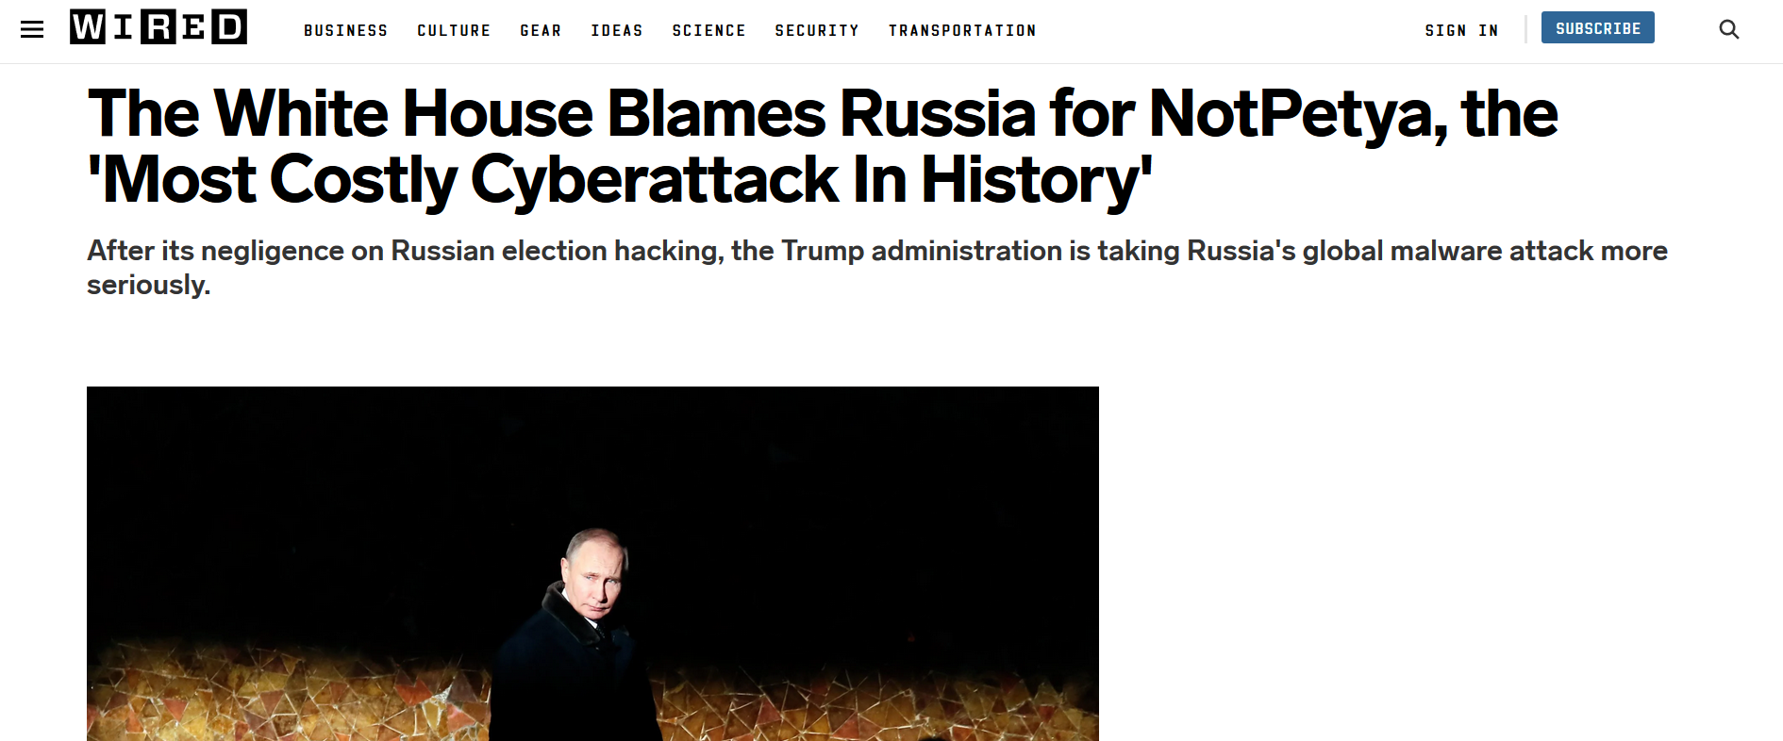
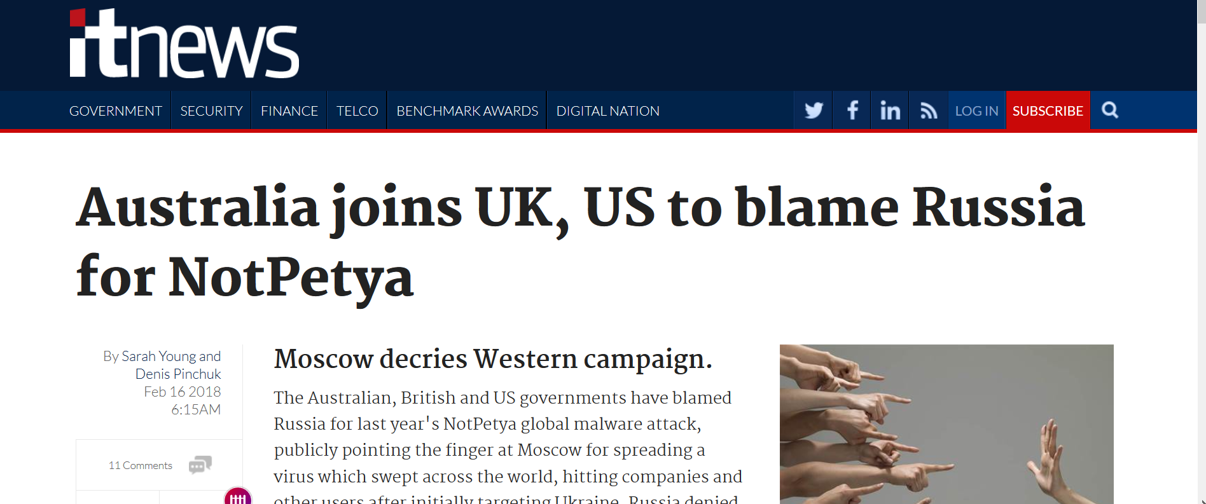
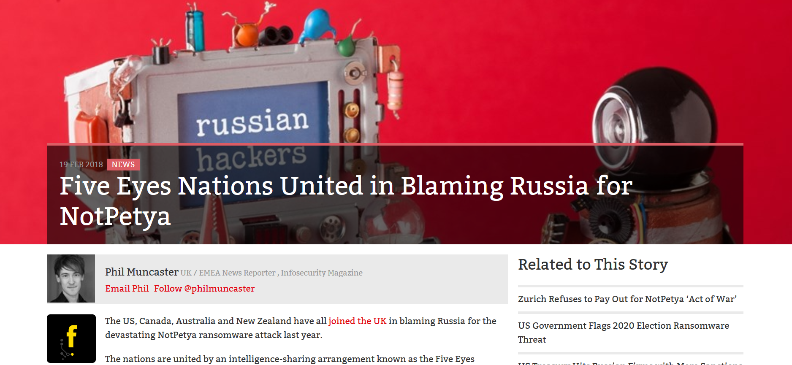
Changing the cyberwar landscape

Slide 17
Food For Thought
Why did Russia leak Eternal Blue in the first place?
Why no visible action was taken against Russia?

Slide 18
Thank You!

